Slide 1
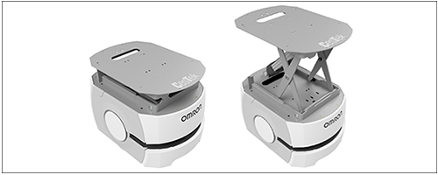
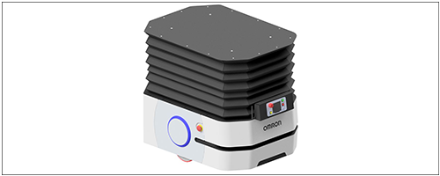
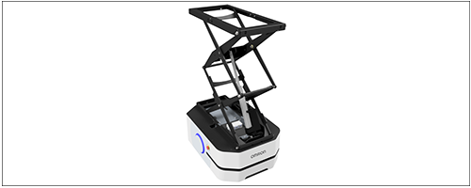
Lifts for LD-series
REX 100
420 mm
Lift for LD-60/90
Payload up to 100 kg
Lifting height 420 mm in 60 seconds
Transport of boxes, trays, sacks etc.
PAYLOAD
100 kg
REX 250 C
440 mm
Lift for LD-250
Payload up to 200 kg
Lifting height 440 mm
Transport of boxes, trays, sacks, half pallets
Compatible with our topconveyor CNV61R
PAYLOAD
200 kg
REX 250 M
1060 mm
Lift for LD-250
Payload up to 100 kg
Lifting height 1060 mm
Transport of boxes, trays, sacks etc.
Compatible with our topconveyor CNV61R
PAYLOAD
100 kg
www.cestek.dk/cestek-special-moduler
Notes:
10 sec.

Slide 2
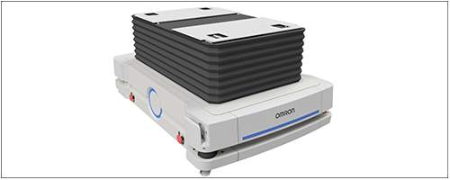
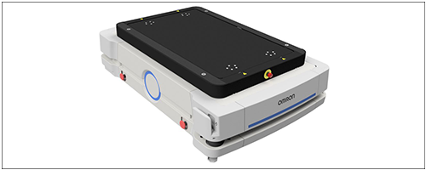
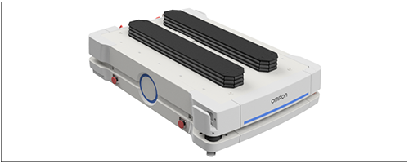
Lifts for HD-1500
REX 1250 LL
390 mm
Lift for HD-1500
Payload up to 1250 kg
Lifting height 390 mm
Transport of boxes, trays, pallets, sacks etc.
Compatible with our topconveyor CNV61R250
PAYLOAD
1250 kg
HDX 35 C
150 mm
Lift for HD-1500
Payload up to 1200 kg
Lifting height 150 mm
Transport of boxes, trays, pallets, sacks etc.
Compatible with our topconveyor CNV61R250
PAYLOAD
1200 kg
HDX 40 E
200 mm
Lift for HD-1500
Payload up to 1500 kg
Lifting height 200 mm
Transport of pallets
PAYLOAD
1500 kg
www.cestek.dk/cestek-special-moduler
Notes:
10 sec.

Slide 3
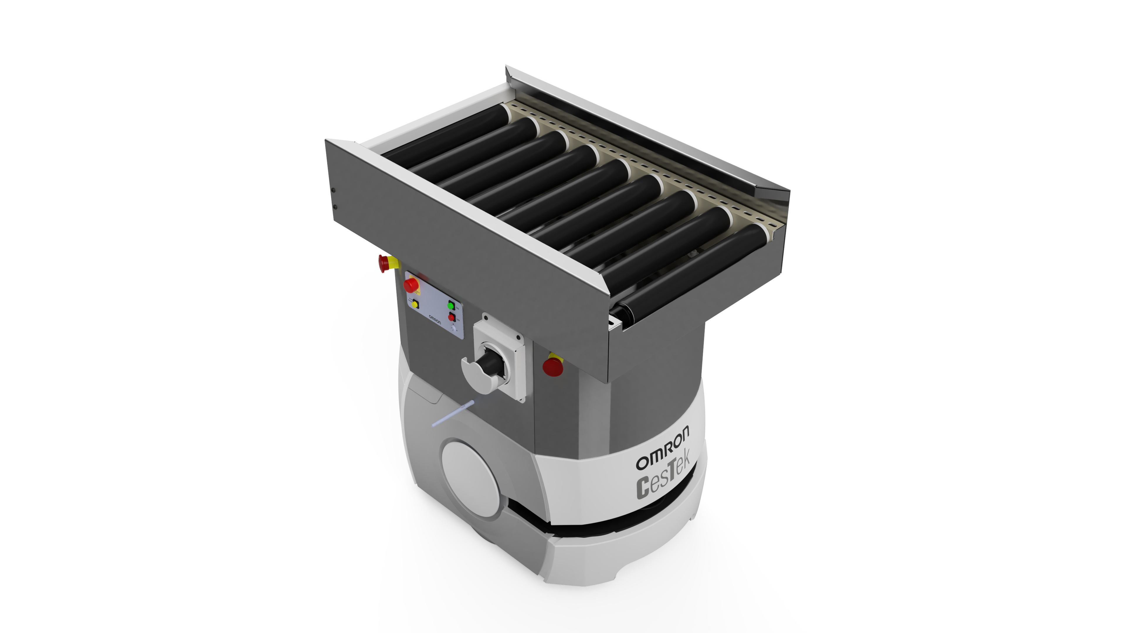
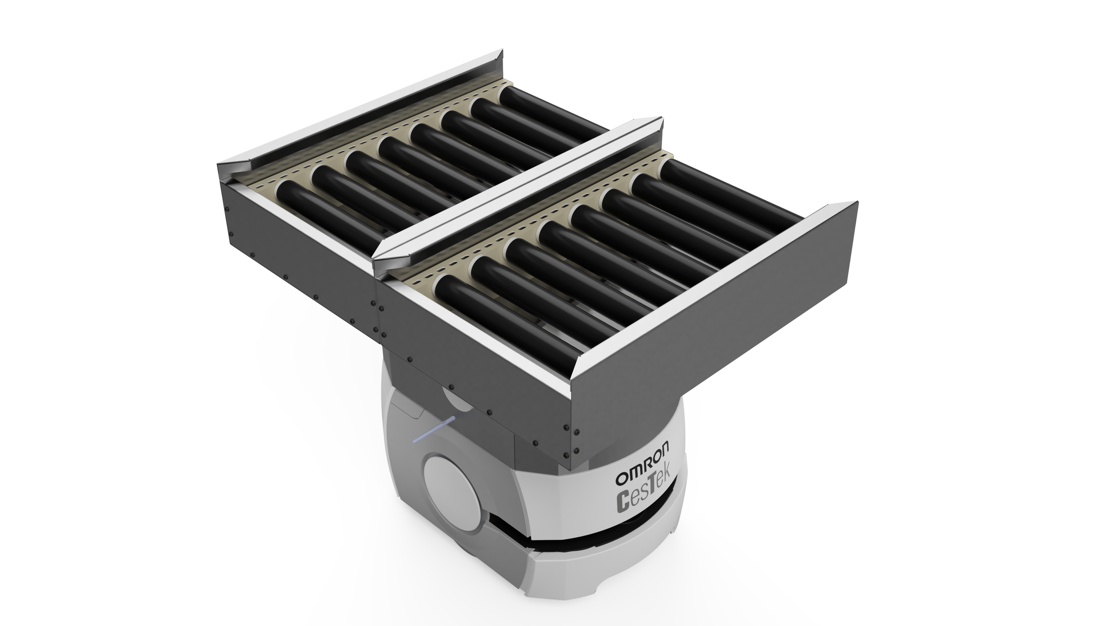
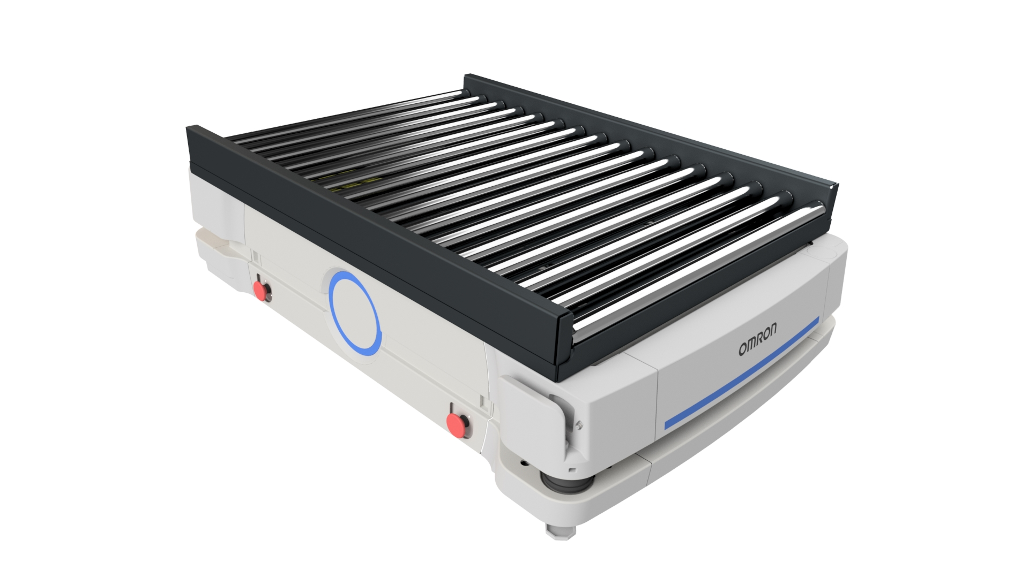
Top Conveyors
CNV61R60 – CesTek Single Conveyor
CesTek Spacer
Conveyor with aluminium Chassis
Steel Rollers
Option:
PUR-coated rollers
LD-60/90
CNV62R60 – CesTek Double Conveyor
CesTek Spacer
Conveyor with aluminium Chassis
Steel Rollers
Option:
PUR-coated rollers
LD-60/90
CNV61R1500 – CesTek Single Conveyor
Options:
PUR-coated rollers
Sidelasers
Lifting unit
Pallet stand
Weight measurements
HD-1500
www.cestek.dk/cestek-special-moduler
Notes:
10 sec.

